Slide 1
Lecture 10: Recurrent Neural Networks
cs231n_study_AI_Robotics
HanDong Lim
2019.09.16
Fei-Fei Li & Justin Johnson & Serena Yeung
1
Fei-Fei Li & Justin Johnson & Serena Yeung Lecture 10 - May 2, 2019

Slide 2
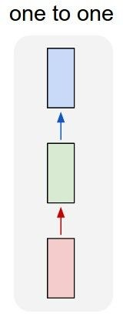
“Vanilla” Neural Network
Vanilla Neural Networks
Fei-Fei Li & Justin Johnson & Serena Yeung
2

Slide 3
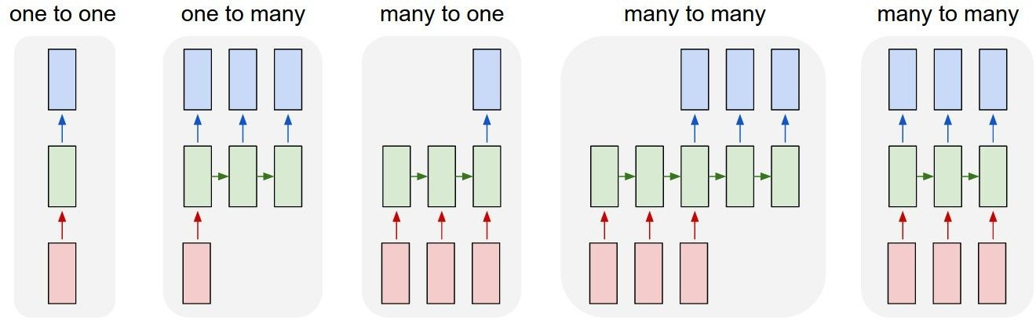
Recurrent Neural Networks: Process Sequences
e.g. Image Captioning
image -> sequence of words
Fei-Fei Li & Justin Johnson & Serena Yeung
3

Slide 4
Recurrent Neural Networks: Process Sequences
e.g. Sentiment Classification
sequence of words -> sentiment
Fei-Fei Li & Justin Johnson & Serena Yeung
4

Slide 5
Recurrent Neural Networks: Process Sequences
e.g. Machine Translation
seq of words -> seq of words
Fei-Fei Li & Justin Johnson & Serena Yeung
5

Slide 6
Recurrent Neural Networks: Process Sequences
e.g. Video classification on frame level
Fei-Fei Li & Justin Johnson & Serena Yeung
6

Slide 7
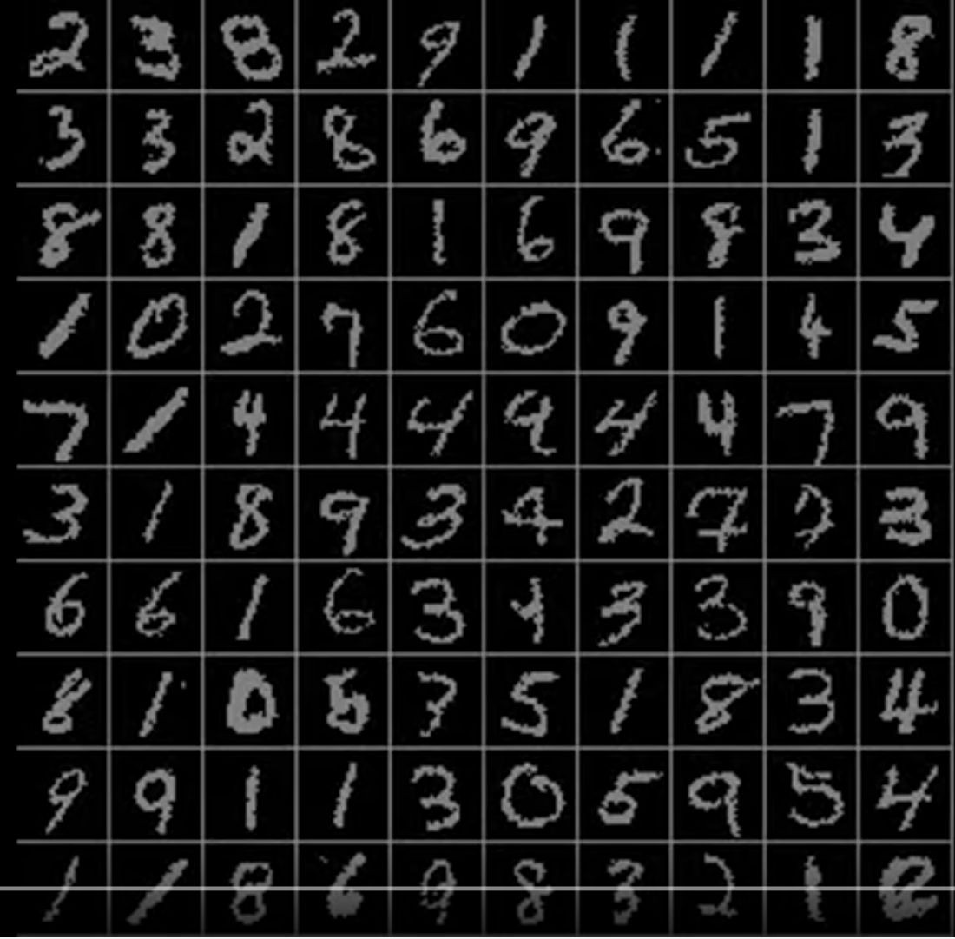
Sequential Processing of Non-Sequence Data
Classify images by taking a series of “glimpses”
Ba, Mnih, and Kavukcuoglu, “Multiple Object Recognition with Visual Attention”, ICLR 2015. Gregor et al, “DRAW: A Recurrent Neural Network For Image Generation”, ICML 2015
Figure copyright Karol Gregor, Ivo Danihelka, Alex Graves, Danilo Jimenez Rezende, and Daan Wierstra,
2015. Reproduced with permission.
Fei-Fei Li & Justin Johnson & Serena Yeung
7

Slide 8
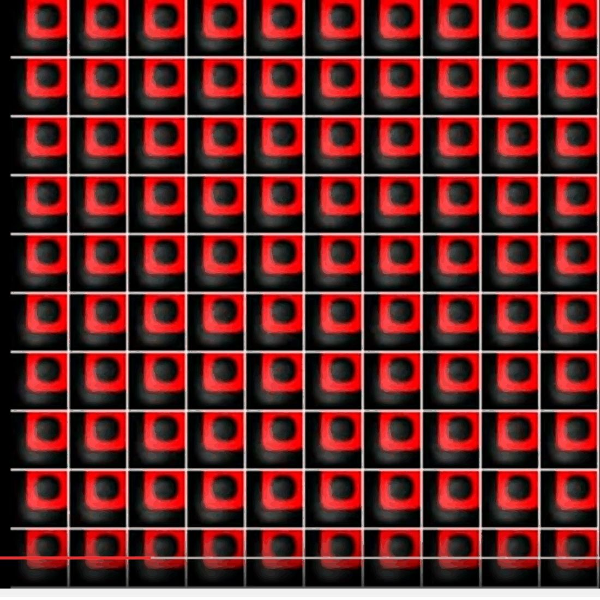
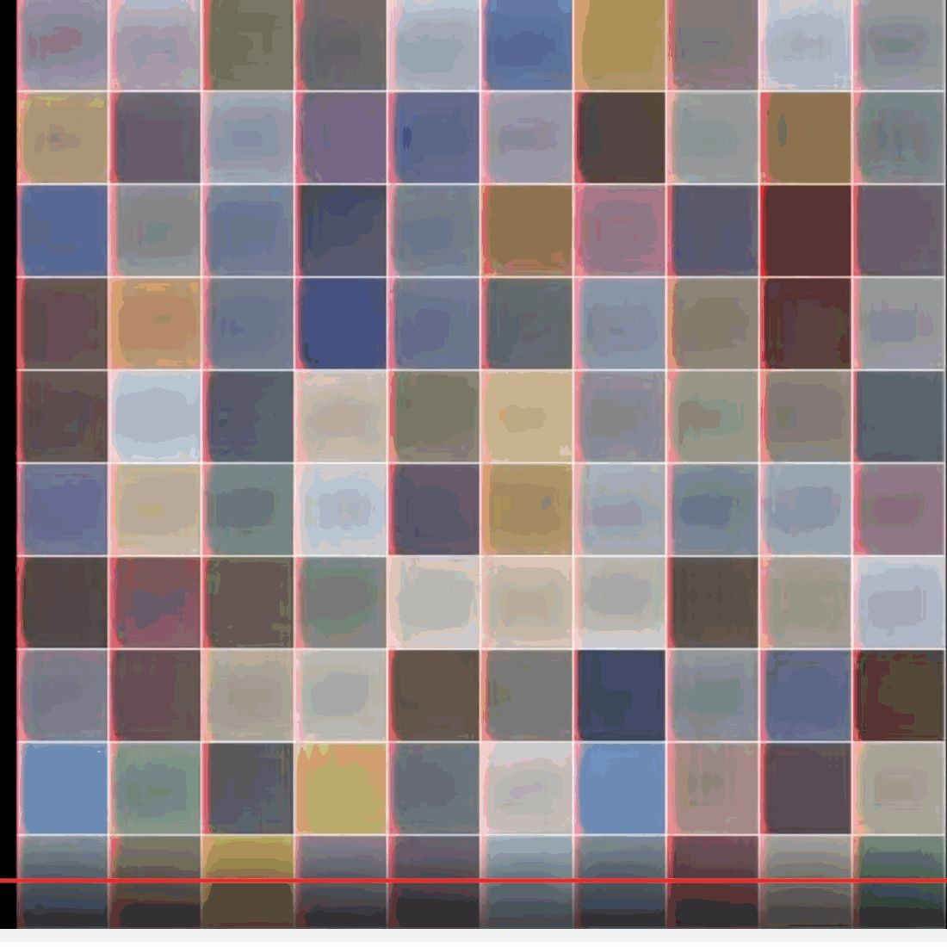
Sequential Processing of Non-Sequence Data
Generate images one piece at a time!
Gregor et al, “DRAW: A Recurrent Neural Network For Image Generation”, ICML 2015
Figure copyright Karol Gregor, Ivo Danihelka, Alex Graves, Danilo Jimenez Rezende, and Daan Wierstra, 2015. Reproduced with permission.
Fei-Fei Li & Justin Johnson & Serena Yeung
17

Slide 9
Recurrent Neural Network
y
Key idea: RNNs have an “internal state” that is updated as a sequence is processed
RNN
x
Fei-Fei Li & Justin Johnson & Serena Yeung
Fei-Fei Li & Justin Johnson & Serena Yeung Lecture 10 - May 2, 2019

Slide 10
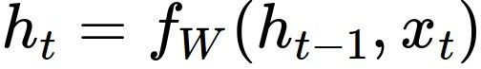
Recurrent Neural Network
We can process a sequence of vectors x by applying a recurrence formula at every time step:
y
RNN
new state old state input vector at
some time step
x
some function
with parameters W
Fei-Fei Li & Justin Johnson & Serena Yeung
Fei-Fei Li & Justin Johnson & Serena Yeung Lecture 10 - May 2, 2019

Slide 11
Recurrent Neural Network
We can process a sequence of vectors x by applying a recurrence formula at every time step:
y
RNN
x
Notice: the same function and the same set of parameters are used at every time step.
Fei-Fei Li & Justin Johnson & Serena Yeung
Fei-Fei Li & Justin Johnson & Serena Yeung Lecture 10 - May 2, 2019

Slide 12
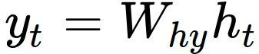
(Simple) Recurrent Neural Network
The state consists of a single “hidden” vector h:
y
RNN
x
Sometimes called a “Vanilla RNN” or an “Elman RNN” after Prof. Jeffrey Elman
Fei-Fei Li & Justin Johnson & Serena Yeung
Fei-Fei Li & Justin Johnson & Serena Yeung Lecture 10 - May 2, 2019

Slide 13
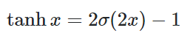
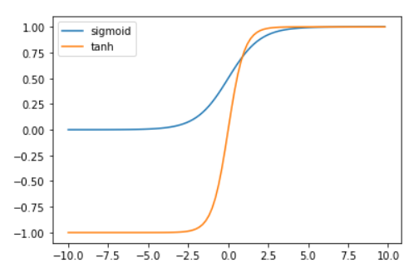
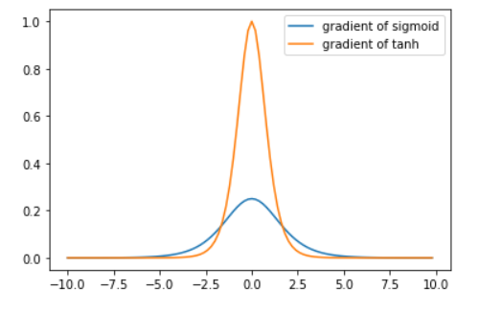
Why tanh not sigmoid?
Constant scaling, 혹은 learning rate으로 조정 가능하므로 어떻게 생각해보면 중요한 문제가 아닐 수도 있다?

Slide 14
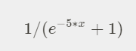
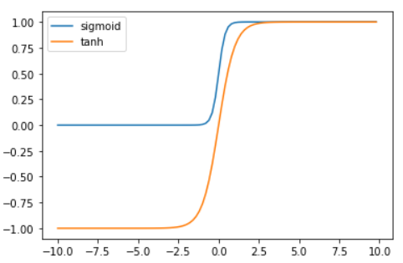
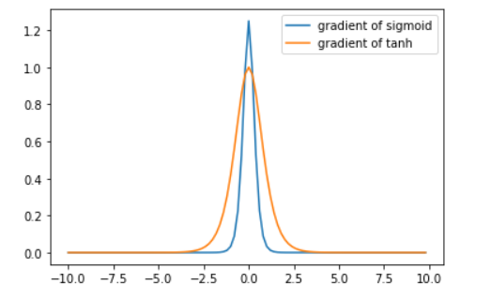

Slide 15
RNN: Computational Graph
h₀
h₁
f_{W}
x₁
Fei-Fei Li & Justin Johnson & Serena Yeung
Fei-Fei Li & Justin Johnson & Serena Yeung Lecture 10 - May 2, 2019

Slide 16
RNN: Computational Graph
h₀
h₁
h₂
f_{W}
f_{W}
x₁
x₂
Fei-Fei Li & Justin Johnson & Serena Yeung
Fei-Fei Li & Justin Johnson & Serena Yeung Lecture 10 - May 2, 2019

Slide 17
RNN: Computational Graph
h₀
h₁
h₂
h₃
…
h_{T}
f_{W}
f_{W}
f_{W}
x₁
x₂
x₃
Fei-Fei Li & Justin Johnson & Serena Yeung
Fei-Fei Li & Justin Johnson & Serena Yeung Lecture 10 - May 2, 2019

Slide 18
RNN: Computational Graph
Re-use the same weight matrix at every time-step
h₂
h₃
…
h_{T}
h₀
f_{W}
h₁
f_{W}
f_{W}
x₁
x₂
x₃
W
Fei-Fei Li & Justin Johnson & Serena Yeung
Fei-Fei Li & Justin Johnson & Serena Yeung Lecture 10 - May 2, 2019

Slide 19
RNN: Computational Graph: Many to Many
y₁
y₂
y₃
y_{T}
h₂
h₃
…
h_{T}
h₀
f_{W}
h₁
f_{W}
f_{W}
x₁
x₂
x₃
W
Fei-Fei Li & Justin Johnson & Serena Yeung
Fei-Fei Li & Justin Johnson & Serena Yeung Lecture 10 - May 2, 2019

Slide 20
RNN: Computational Graph: Many to Many
y₁
y₂
y₃
y_{T}
L₁
L₂
L₃
L_{T}
h₂
h₃
…
h_{T}
h₀
f_{W}
h₁
f_{W}
f_{W}
x₁
x₂
x₃
W
Fei-Fei Li & Justin Johnson & Serena Yeung
Fei-Fei Li & Justin Johnson & Serena Yeung Lecture 10 - May 2, 2019

Slide 21
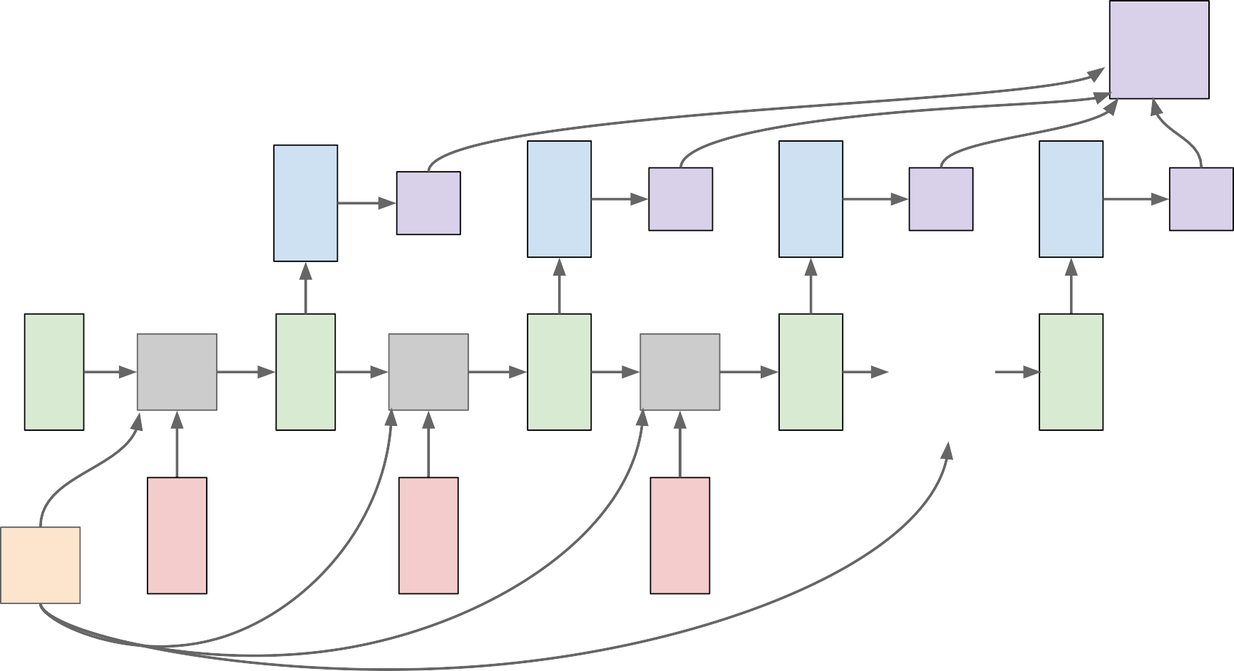
RNN: Computational Graph: Many to Many
L
f_{W} | y₁ h₁ | L₁ f_{W} | y₂ h₂ | L₂ f_{W} | y₃ h₃ | L₃ … | y_{T} h_{T} | L_{T}
x₁ |  | x₂ |  | x₃
h₀
W
Fei-Fei Li & Justin Johnson & Serena Yeung
Fei-Fei Li & Justin Johnson & Serena Yeung Lecture 10 - May 2, 2019

Slide 22
RNN: Computational Graph: Many to One
y
h₂
h₃
…
h_{T}
h₀
f_{W}
h₁
f_{W}
f_{W}
x₁
x₂
x₃
W
Fei-Fei Li & Justin Johnson & Serena Yeung
Fei-Fei Li & Justin Johnson & Serena Yeung Lecture 10 - May 2, 2019

Slide 23
RNN: Computational Graph: One to Many
y₁
y₂
y₃
y_{T}
h₂
h₃
…
h_{T}
h₀
f_{W}
h₁
f_{W}
f_{W}
x
W
Fei-Fei Li & Justin Johnson & Serena Yeung
Fei-Fei Li & Justin Johnson & Serena Yeung Lecture 10 - May 2, 2019

Slide 24
Sequence to Sequence: Many-to-one + one-to-many
Many to one: Encode input sequence in a single vector
h
0
f_{W}
h
1
f_{W}
h
2
f_{W}
h
3
…
h
T
x
1
x
2
x
3
W
1
Sutskever et al, “Sequence to Sequence Learning with Neural Networks”, NIPS 2014
Fei-Fei Li & Justin Johnson & Serena Yeung
Fei-Fei Li & Justin Johnson & Serena Yeung Lecture 10 - May 2, 2019

Slide 25
Sequence to Sequence: Many-to-one + one-to-many
One to many: Produce output sequence from single input vector
Many to one: Encode input
sequence in a single vector
y
1
y
2
h
0
f_{W}
h
1
f_{W}
h
2
f_{W}
h
3
…
h
T
h
1
h
2
…
f_{W}
f_{W}
f_{W}
x
1
x
2
x
3
W
W
1
2
Sutskever et al, “Sequence to Sequence Learning with Neural Networks”, NIPS 2014
Fei-Fei Li & Justin Johnson & Serena Yeung
Fei-Fei Li & Justin Johnson & Serena Yeung Lecture 10 - May 2, 2019

Slide 26
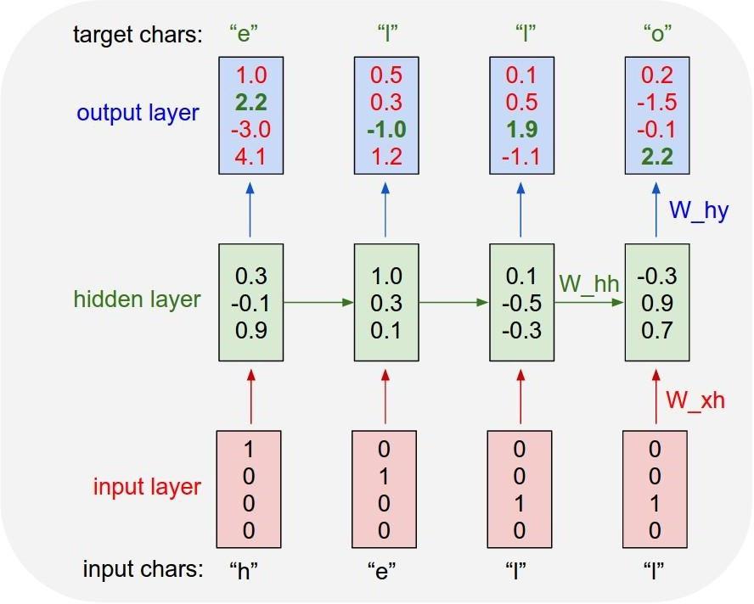
Example: Character-level Language Model
Vocabulary: [h,e,l,o]
Example training sequence: “hello”
Fei-Fei Li & Justin Johnson & Serena Yeung
Fei-Fei Li & Justin Johnson & Serena Yeung Lecture 10 - May 2, 2019

Slide 27
Example: Character-level Language Model
Vocabulary: [h,e,l,o]
Example training sequence: “hello”
Fei-Fei Li & Justin Johnson & Serena Yeung
Fei-Fei Li & Justin Johnson & Serena Yeung Lecture 10 - May 2, 2019

Slide 28
Example: Character-level Language Model
Vocabulary: [h,e,l,o]
Example training sequence: “hello”
Fei-Fei Li & Justin Johnson & Serena Yeung
Fei-Fei Li & Justin Johnson & Serena Yeung Lecture 10 - May 2, 2019

Slide 29
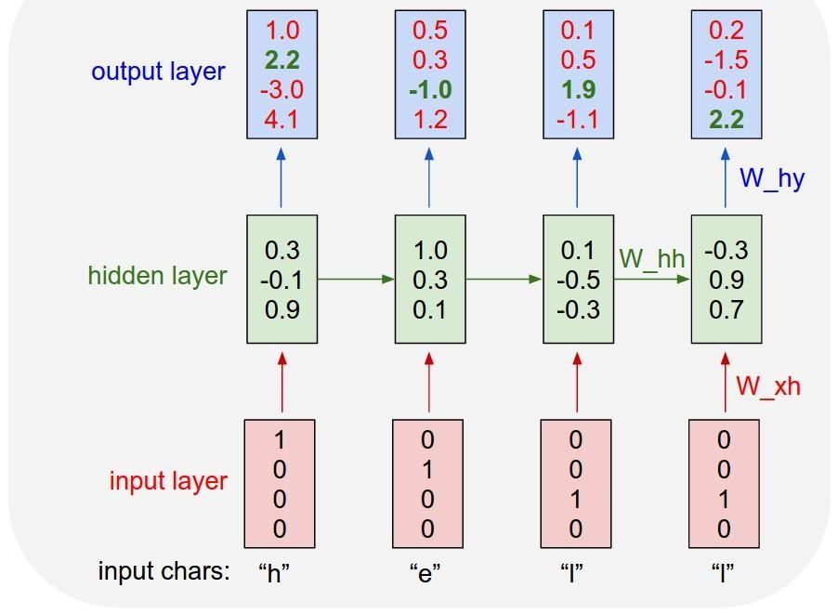
Example: Character-level Language Model Sampling
“e”
“l”
.25
.20
.05
.50
“l” “o”
.11 .11
.17 .02
.68 .08
.03 .79
Sample
.03
.13
.00
.84
Softmax
Vocabulary: [h,e,l,o]
At test-time sample characters one at a time, feed back to model
Fei-Fei Li & Justin Johnson & Serena Yeung
Fei-Fei Li & Justin Johnson & Serena Yeung Lecture 10 - May 2, 2019

Slide 30
Example: Character-level Language Model Sampling
Test time 에 softmax vector가 아닌 one hot vecotor 를 넣어주는 이유:
Computational load(English vocabulary very large)
Training 때와 다른 vector를 본다.
“e”
“l”
.25
.20
.05
.50
“l” “o”
.11 .11
.17 .02
.68 .08
.03 .79
Sample
.03
.13
.00
.84
Softmax
Vocabulary: [h,e,l,o]
At test-time sample characters one at a time, feed back to model(Sampling 하면 argmax보다 diversity 측면에서 좋다)
Fei-Fei Li & Justin Johnson & Serena Yeung
Fei-Fei Li & Justin Johnson & Serena Yeung Lecture 10 - May 2, 2019

Slide 31
Example: Character-level Language Model Sampling
“e”
“l”
“l” “o”
.11 .11
.17 .02
.68 .08
.03 .79
Sample
.03
.13
.00
.84
.25
.20
.05
.50
Softmax
Vocabulary: [h,e,l,o]
At test-time sample characters one at a time, feed back to model
Fei-Fei Li & Justin Johnson & Serena Yeung
Fei-Fei Li & Justin Johnson & Serena Yeung Lecture 10 - May 2, 2019

Slide 32
Example: Character-level Language Model Sampling
“e” |  | “l” |  | “l” |  | “o”
.03 |  | .25 |  | .11 |  | .11
.13 |  | .20 |  | .17 |  | .02
.00 |  | .05 |  | .68 |  | .08
.84 |  | .50 |  | .03 |  | .79
Sample
Softmax
Vocabulary: [h,e,l,o]
At test-time sample characters one at a time, feed back to model
Fei-Fei Li & Justin Johnson & Serena Yeung
Fei-Fei Li & Justin Johnson & Serena Yeung Lecture 10 - May 2, 2019

Slide 33


Backpropagation through time
Forward through entire sequence to compute loss, then backward through entire sequence to compute gradient
Loss
Fei-Fei Li & Justin Johnson & Serena Yeung
Fei-Fei Li & Justin Johnson & Serena Yeung Lecture 10 - May 2, 2019

Slide 34
Truncated Backpropagation through time
Loss
Run forward and backward through chunks of the sequence instead of whole sequence
Fei-Fei Li & Justin Johnson & Serena Yeung
Fei-Fei Li & Justin Johnson & Serena Yeung Lecture 10 - May 2, 2019

Slide 35
Truncated Backpropagation through time
Loss
Carry hidden states forward in time forever, but only backpropagate for some smaller number of steps
Fei-Fei Li & Justin Johnson & Serena Yeung
Fei-Fei Li & Justin Johnson & Serena Yeung Lecture 10 - May 2, 2019

Slide 36
Truncated Backpropagation through time
Loss
Fei-Fei Li & Justin Johnson & Serena Yeung
Fei-Fei Li & Justin Johnson & Serena Yeung Lecture 10 - May 2, 2019

Slide 37
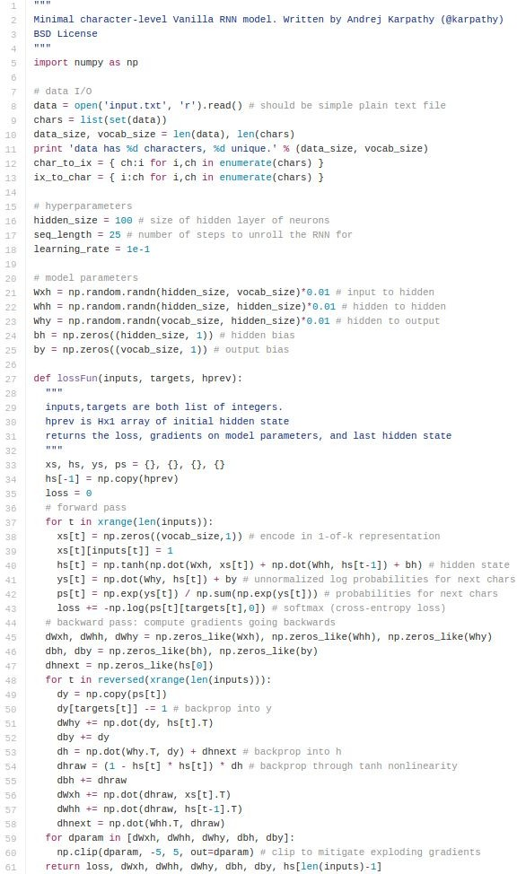
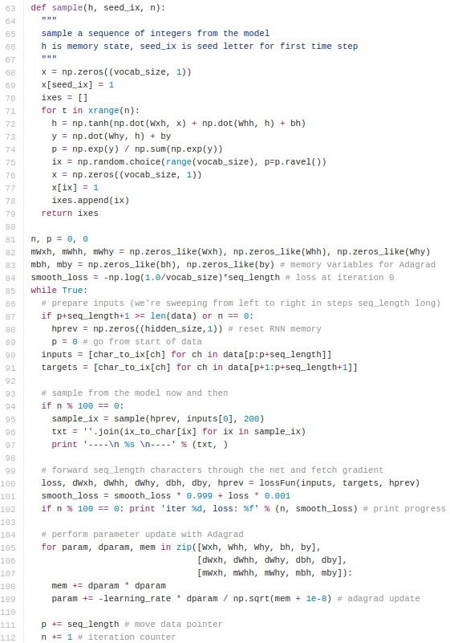
min-char-rnn.py gist: 112 lines of Python
(https://gist.github.com/karpathy/d4dee 566867f8291f086)
Fei-Fei Li & Justin Johnson & Serena Yeung
Fei-Fei Li & Justin Johnson & Serena Yeung Lecture 10 - May 2, 2019

Slide 38
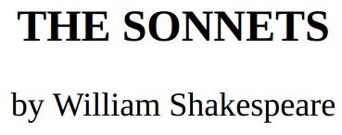
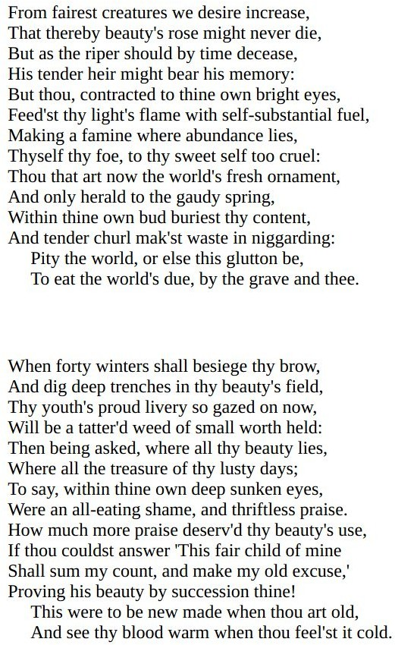
y
RNN
x
Fei-Fei Li & Justin Johnson & Serena Yeung
Fei-Fei Li & Justin Johnson & Serena Yeung Lecture 10 - May 2, 2019

Slide 39
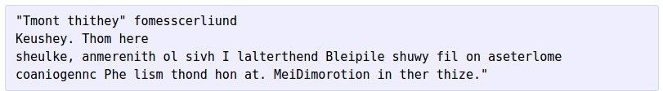
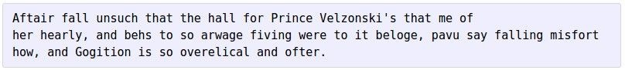
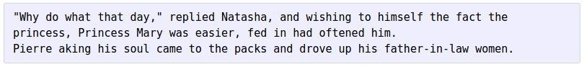
at first:
train more
train more
train more
Fei-Fei Li & Justin Johnson & Serena Yeung
Fei-Fei Li & Justin Johnson & Serena Yeung Lecture 10 - May 2, 2019

Slide 40
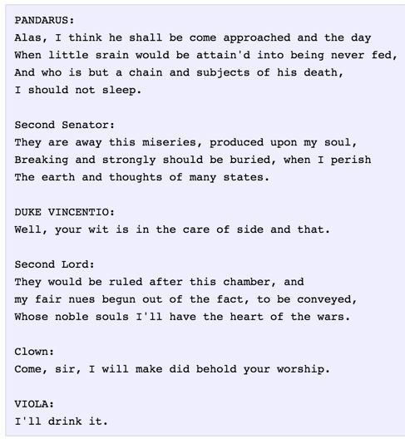
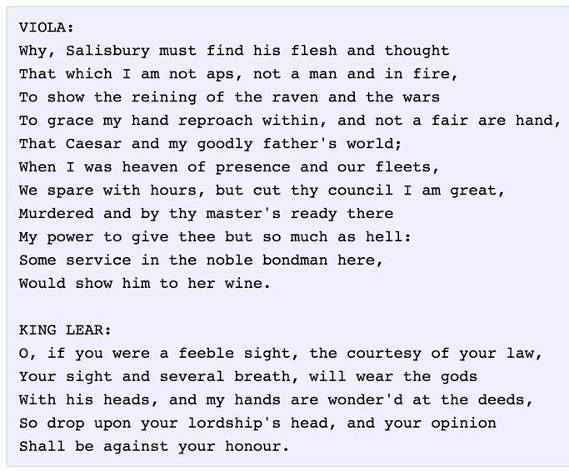
Fei-Fei Li & Justin Johnson & Serena Yeung
Fei-Fei Li & Justin Johnson & Serena Yeung Lecture 10 - May 2, 2019

Slide 41
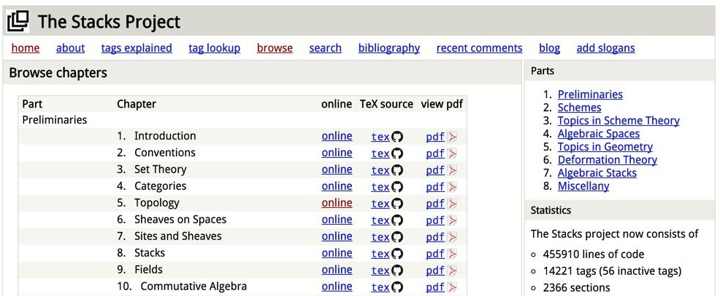
The Stacks Project: open source algebraic geometry textbook
Latex source
http://stacks.math.columbia.edu/
The stacks project is licensed under the GNU Free Documentation License
Fei-Fei Li & Justin Johnson & Serena Yeung
Fei-Fei Li & Justin Johnson & Serena Yeung Lecture 10 - May 2, 2019

Slide 42
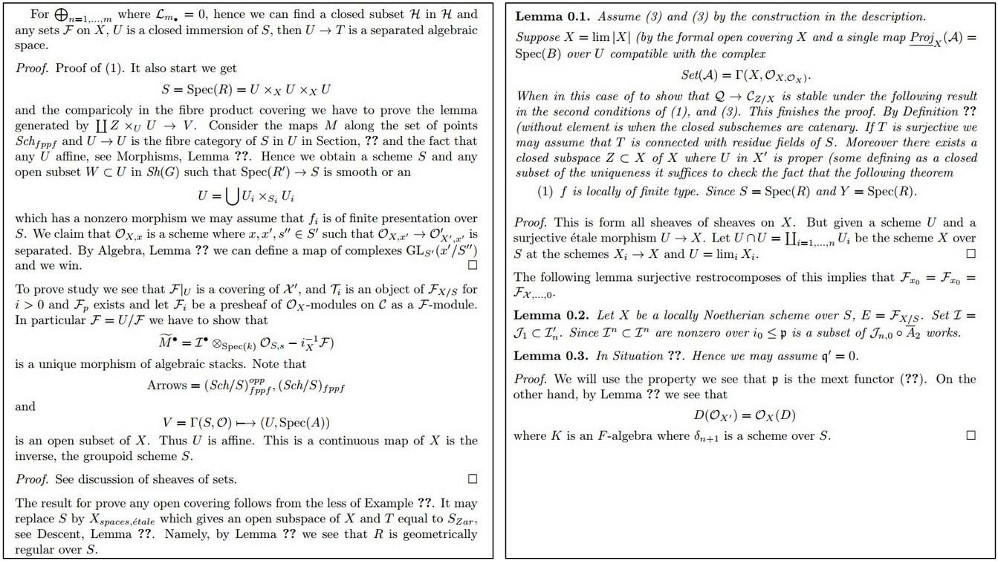
Fei-Fei Li & Justin Johnson & Serena Yeung
Fei-Fei Li & Justin Johnson & Serena Yeung Lecture 10 - May 2, 2019

Slide 43
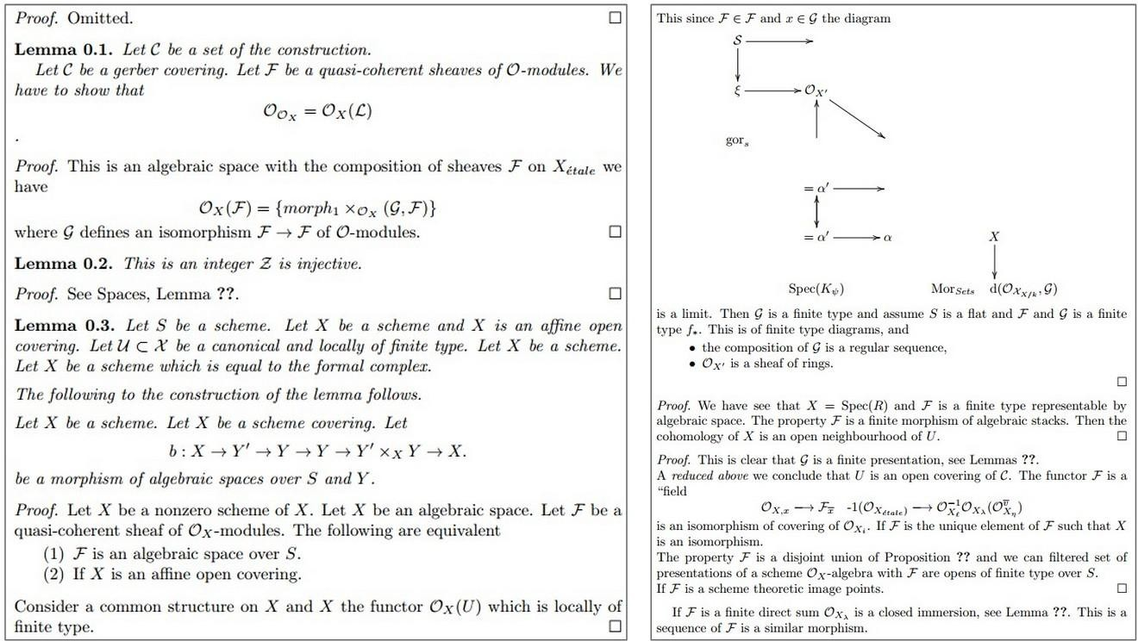
Fei-Fei Li & Justin Johnson & Serena Yeung
Fei-Fei Li & Justin Johnson & Serena Yeung Lecture 10 - May 2, 2019

Slide 44
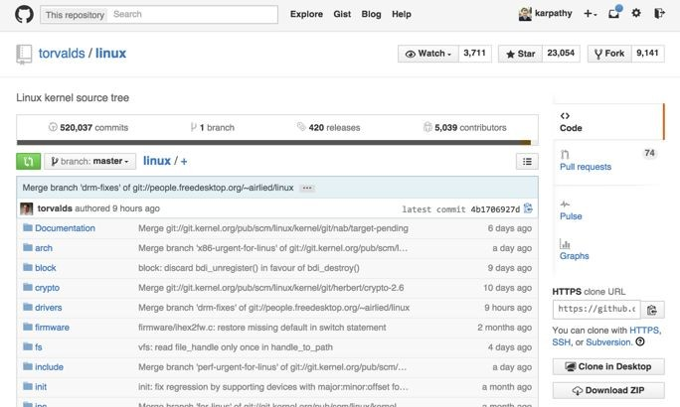
Fei-Fei Li & Justin Johnson & Serena Yeung
Fei-Fei Li & Justin Johnson & Serena Yeung Lecture 10 - May 2, 2019

Slide 45
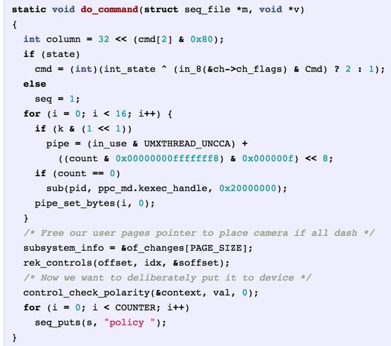
Generated C code
Fei-Fei Li & Justin Johnson & Serena Yeung
Fei-Fei Li & Justin Johnson & Serena Yeung Lecture 10 - May 2, 2019

Slide 46
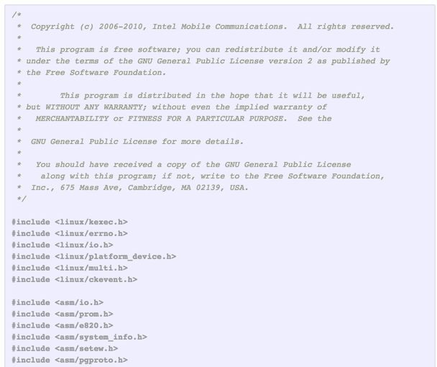
Fei-Fei Li & Justin Johnson & Serena Yeung
Fei-Fei Li & Justin Johnson & Serena Yeung Lecture 10 - May 2, 2019

Slide 47
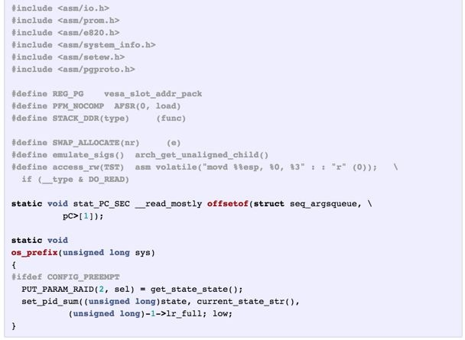
Fei-Fei Li & Justin Johnson & Serena Yeung
Fei-Fei Li & Justin Johnson & Serena Yeung Lecture 10 - May 2, 2019

Slide 48
Searching for interpretable cells
Karpathy, Johnson, and Fei-Fei: Visualizing and Understanding Recurrent Networks, ICLR Workshop 2016
Fei-Fei Li & Justin Johnson & Serena Yeung
Fei-Fei Li & Justin Johnson & Serena Yeung Lecture 10 - May 2, 2019

Slide 49
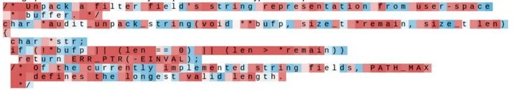
Searching for interpretable cells
Karpathy, Johnson, and Fei-Fei: Visualizing and Understanding Recurrent Networks, ICLR Workshop 2016
Figures copyright Karpathy, Johnson, and Fei-Fei, 2015; reproduced with permission
Fei-Fei Li & Justin Johnson & Serena Yeung
Fei-Fei Li & Justin Johnson & Serena Yeung Lecture 10 - May 2, 2019

Slide 50
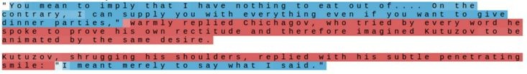
Searching for interpretable cells
quote detection cell
Karpathy, Johnson, and Fei-Fei: Visualizing and Understanding Recurrent Networks, ICLR Workshop 2016
Figures copyright Karpathy, Johnson, and Fei-Fei, 2015; reproduced with permission
Fei-Fei Li & Justin Johnson & Serena Yeung
Fei-Fei Li & Justin Johnson & Serena Yeung Lecture 10 - May 2, 2019

Slide 51
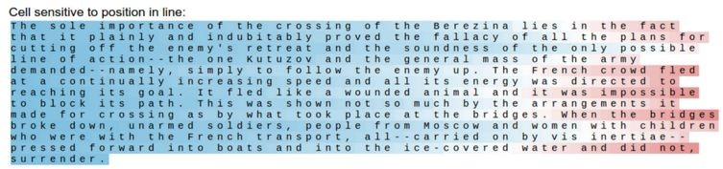
Searching for interpretable cells
line length tracking cell
Karpathy, Johnson, and Fei-Fei: Visualizing and Understanding Recurrent Networks, ICLR Workshop 2016
Figures copyright Karpathy, Johnson, and Fei-Fei, 2015; reproduced with permission
Fei-Fei Li & Justin Johnson & Serena Yeung
Fei-Fei Li & Justin Johnson & Serena Yeung Lecture 10 - May 2, 2019

Slide 52
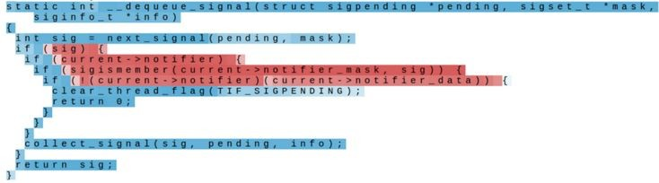
Searching for interpretable cells
if statement cell
Karpathy, Johnson, and Fei-Fei: Visualizing and Understanding Recurrent Networks, ICLR Workshop 2016
Figures copyright Karpathy, Johnson, and Fei-Fei, 2015; reproduced with permission
Fei-Fei Li & Justin Johnson & Serena Yeung
Fei-Fei Li & Justin Johnson & Serena Yeung Lecture 10 - May 2, 2019

Slide 53
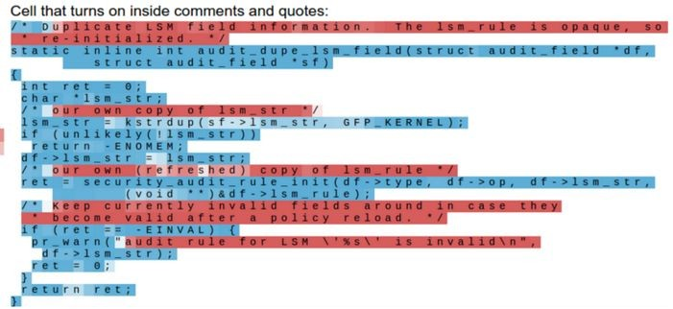
Searching for interpretable cells
quote/comment cell
Karpathy, Johnson, and Fei-Fei: Visualizing and Understanding Recurrent Networks, ICLR Workshop 2016
Figures copyright Karpathy, Johnson, and Fei-Fei, 2015; reproduced with permission
Fei-Fei Li & Justin Johnson & Serena Yeung
Fei-Fei Li & Justin Johnson & Serena Yeung Lecture 10 - May 2, 2019

Slide 54
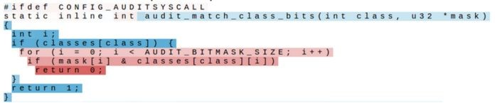
Searching for interpretable cells
code depth cell
Karpathy, Johnson, and Fei-Fei: Visualizing and Understanding Recurrent Networks, ICLR Workshop 2016
Figures copyright Karpathy, Johnson, and Fei-Fei, 2015; reproduced with permission
Fei-Fei Li & Justin Johnson & Serena Yeung
Fei-Fei Li & Justin Johnson & Serena Yeung Lecture 10 - May 2, 2019

Slide 55
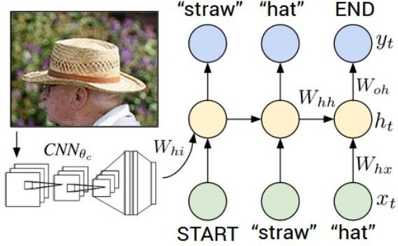
Image Captioning
Figure from Karpathy et a, “Deep
Visual-Semantic Alignments for Generating Image Descriptions”, CVPR 2015; figure copyright IEEE, 2015.
Reproduced for educational purposes.
Explain Images with Multimodal Recurrent Neural Networks, Mao et al.
Deep Visual-Semantic Alignments for Generating Image Descriptions, Karpathy and Fei-Fei Show and Tell: A Neural Image Caption Generator, Vinyals et al.
Long-term Recurrent Convolutional Networks for Visual Recognition and Description, Donahue et al. Learning a Recurrent Visual Representation for Image Caption Generation, Chen and Zitnick
Fei-Fei Li & Justin Johnson & Serena Yeung
Fei-Fei Li & Justin Johnson & Serena Yeung Lecture 10 - May 2, 2019

Slide 56
Recurrent Neural Network
Convolutional Neural Network
Fei-Fei Li & Justin Johnson & Serena Yeung
Fei-Fei Li & Justin Johnson & Serena Yeung Lecture 10 - May 2, 2019

Slide 57
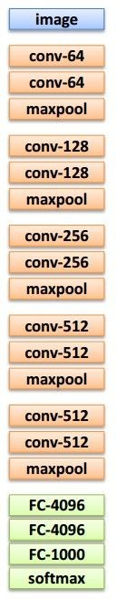

test image
F
ei-Fei Li &
Justin Johnson & Serena Yeung
Lecture 10 -
May 2, 2019

Slide 58
test image
X
F
ei-Fei Li &
Justin Johnson & Serena Yeung
Lecture 10 -
May 2, 2019

Slide 59
test image
x0
<STA RT>
F
ei-Fei Li &
Justin Johnson_{<S}&_{TA}S_{R}e_{T>}rena Yeung
Lecture 10 -
May 2, 2019

Slide 60

test image
y0
before:
h = tanh(Wxh * x + Whh * h)
h0
Wih
now:
h = tanh(Wxh * x + Whh * h + Wih * v)
x0
<STA RT>
v
F
ei-Fei Li &
Justin Johnson_{<S}&_{TA}S_{R}e_{T>}rena Yeung
Lecture 10 -
May 2, 2019

Slide 61
test image
y0
h0
sample!
x0
<STA RT>
straw
F
ei-Fei Li &
Justin Johnson_{<S}&_{TA}S_{R}e_{T>}rena Yeung

Slide 62
test image
y0
y1
h0
h1
x0
<STA RT>
straw
F
ei-Fei Li &
Justin Johnson_{<S}&_{TA}S_{R}e_{T>}rena Yeung

Slide 63
test image
y0
y1
h0
h1
sample!
x0
<STA RT>
straw
hat
F
ei-Fei Li &
Justin Johnson_{<S}&_{TA}S_{R}e_{T>}rena Yeung

Slide 64
test image
y0
y1
y2
h0
h1
h2
x0
<STA RT>
straw
hat
F
ei-Fei Li &
Justin Johnson_{<S}&_{TA}S_{R}e_{T>}rena Yeung

Slide 65
test image
y0
y1
y2
sample
<END> token
=> finish.
h0
h1
h2
x0
<STA RT>
straw
hat
F
ei-Fei Li &
Justin Johnson_{<S}&_{TA}S_{R}e_{T>}rena Yeung

Slide 66


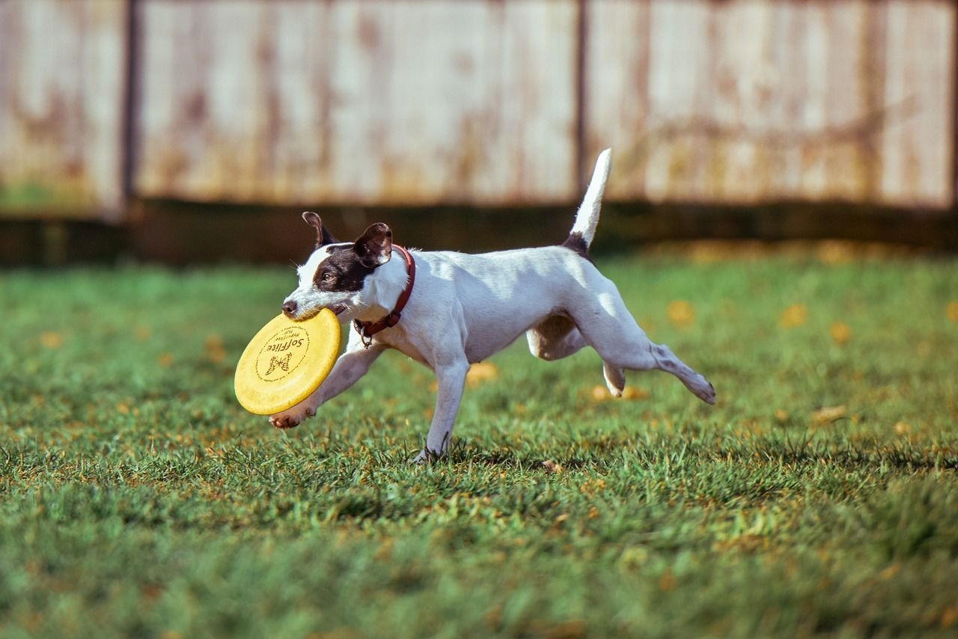


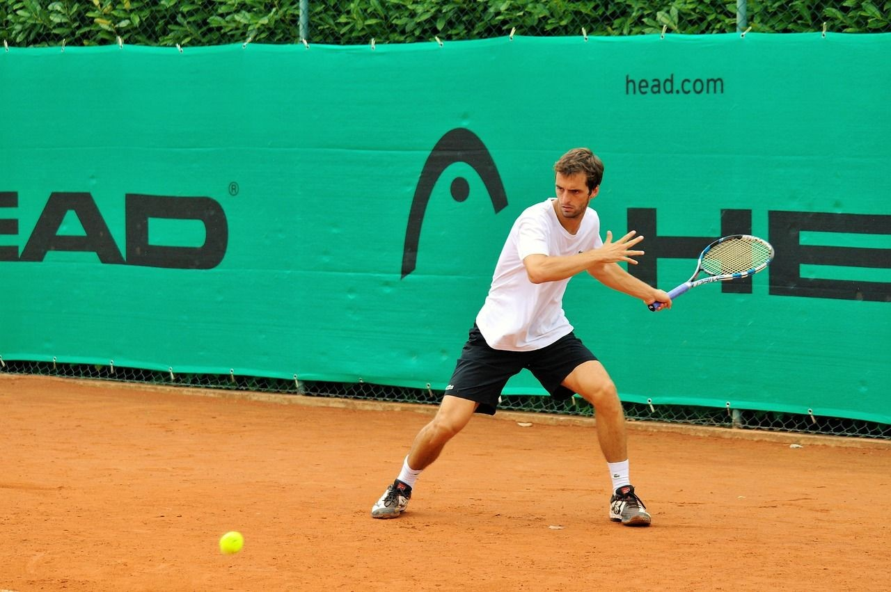
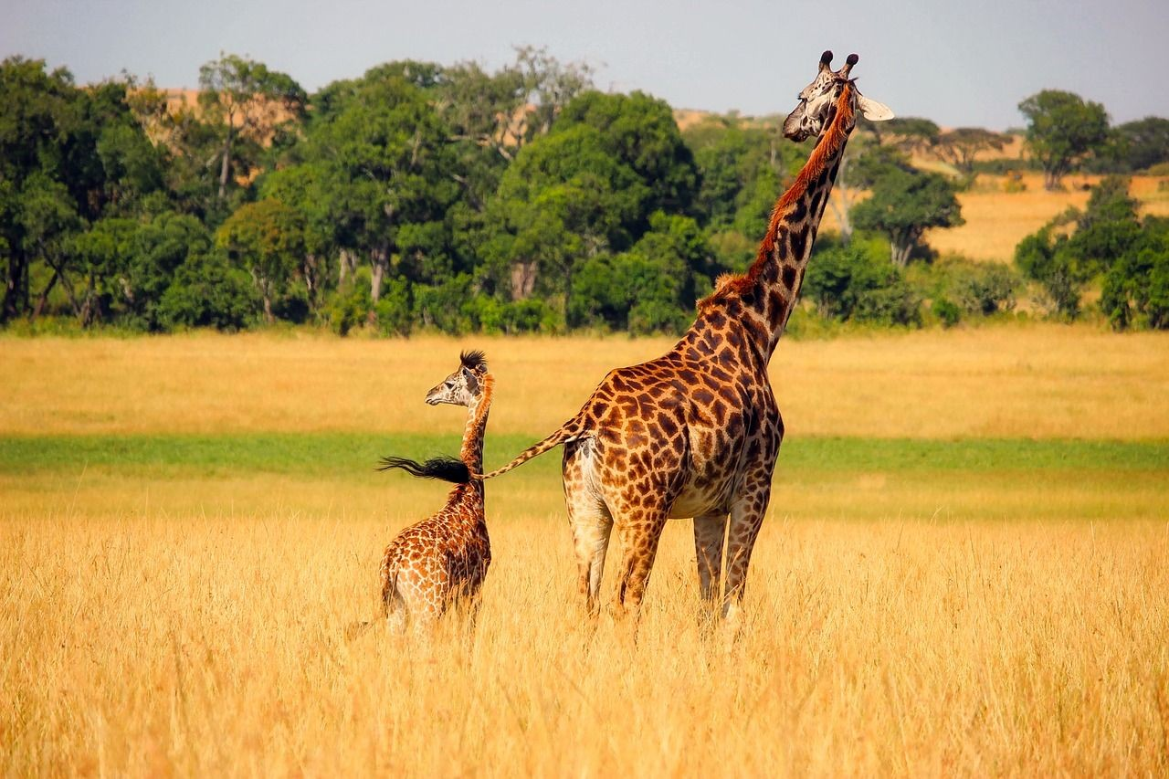
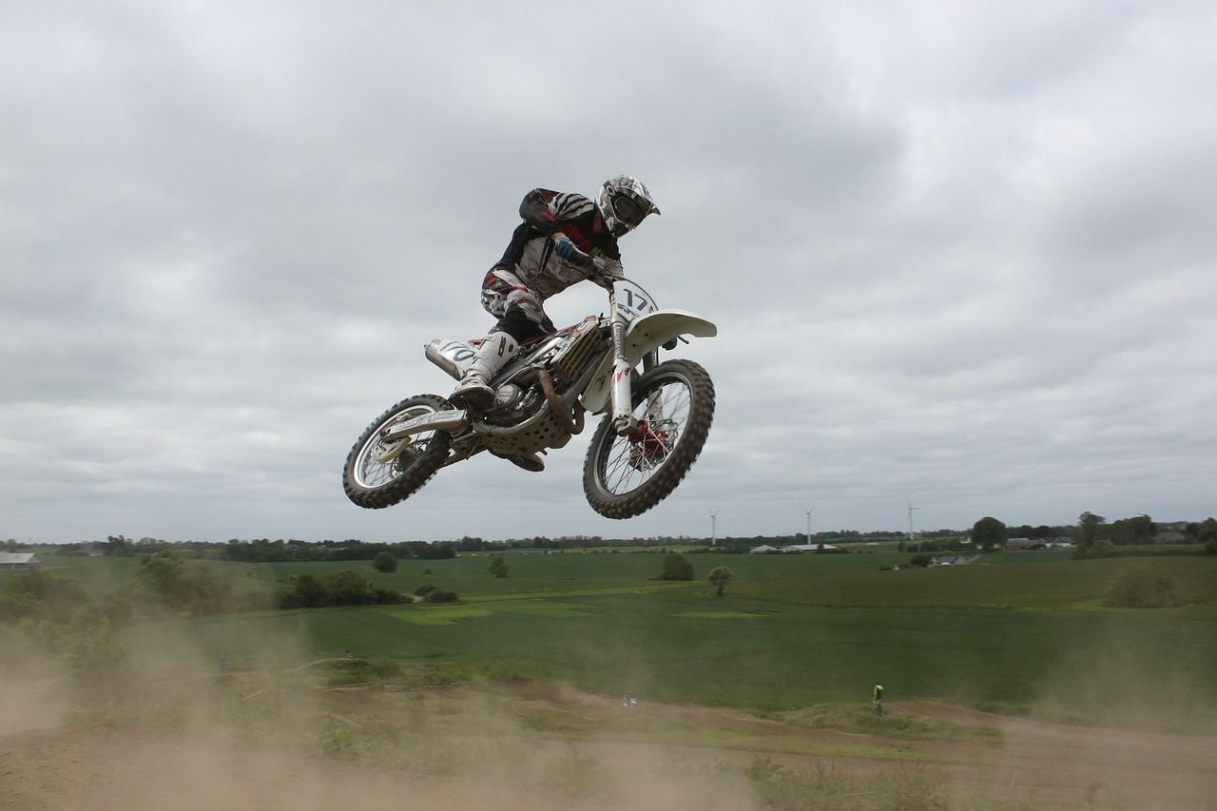
Image Captioning: Example Results
Captions generated using neuraltalk2 All images are CC0 Public domain:
cat suitcase, cat tree, dog, bear,
surfers, tennis, giraffe, motorcycle
A cat sitting on a suitcase on the floor
A cat is sitting on a tree branch
A dog is running in the grass with a frisbee
A white teddy bear sitting in the grass
Two people walking on the beach with surfboards
A tennis player in action on the court
Two giraffes standing in a grassy field
A man riding a dirt bike on a dirt track
Fei-Fei Li & Justin Johnson & Serena Yeung
Fei-Fei Li & Justin Johnson & Serena Yeung Lecture 10 - May 2, 2019

Slide 67

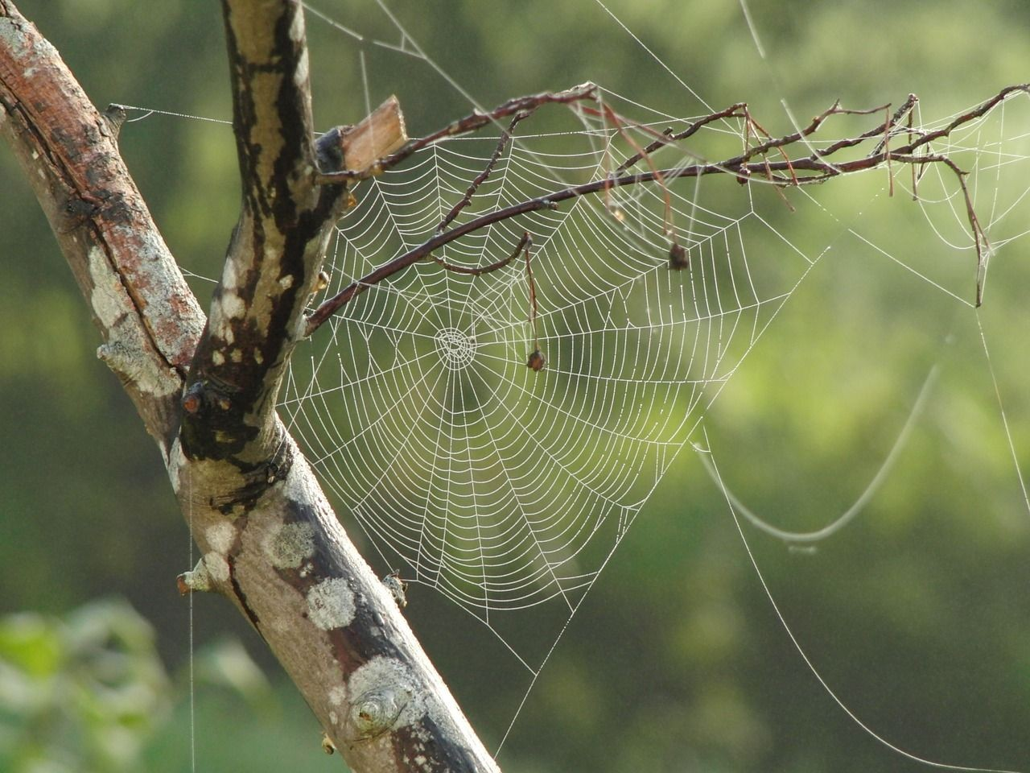


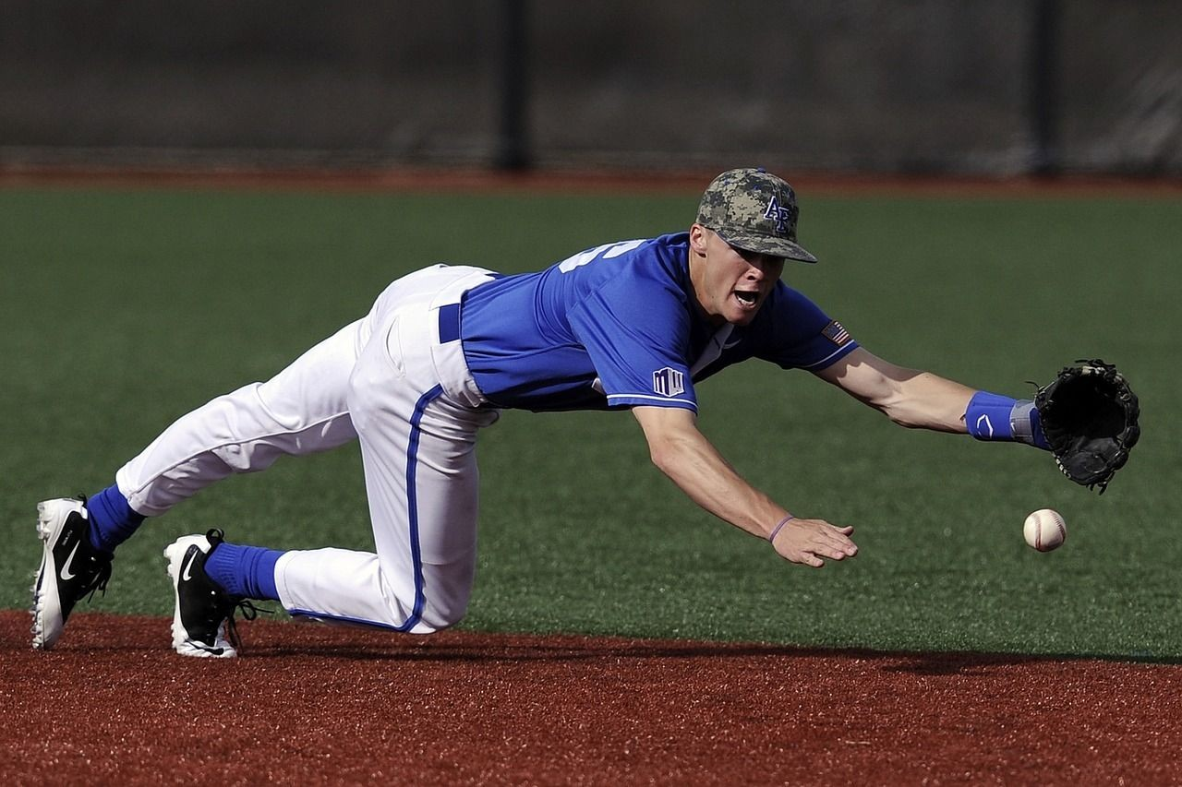
Image Captioning: Failure Cases
Captions generated using neuraltalk2 All images are CC0 Public domain: fur coat, handstand, spider web, baseball
A bird is perched on a tree branch
A woman is holding a cat in her hand
A man in a baseball uniform throwing a ball
A woman standing on a beach holding a surfboard
A person holding a computer mouse on a desk
Fei-Fei Li & Justin Johnson & Serena Yeung
Fei-Fei Li & Justin Johnson & Serena Yeung Lecture 10 - May 2, 2019

Slide 68
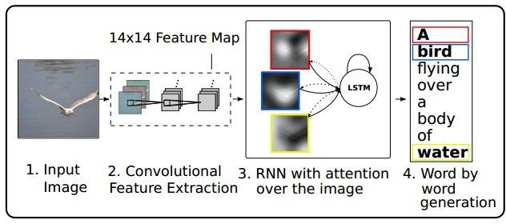
Image Captioning with Attention
RNN focuses its attention at a different spatial location when generating each word
Xu et al, “Show, Attend, and Tell: Neural Image Caption Generation with Visual Attention”, ICML 2015
Figure copyright Kelvin Xu, Jimmy Lei Ba, Jamie Kiros, Kyunghyun Cho, Aaron Courville, Ruslan Salakhutdinov, Richard S. Zemel, and Yoshua Benchio, 2015. Reproduced with permission.
Fei-Fei Li & Justin Johnson & Serena Yeung
Fei-Fei Li & Justin Johnson & Serena Yeung Lecture 10 - May 2, 2019

Slide 69
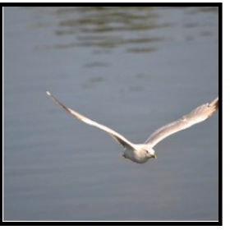

Image Captioning with Attention
CNN
h0
Features: L x D
Image: H x W x 3
Xu et al, “Show, Attend and Tell: Neural
Image Caption Generation with Visual Attention”, ICML 2015
Fei-Fei Li & Justin Johnson & Serena Yeung
Fei-Fei Li & Justin Johnson & Serena Yeung Lecture 10 - May 2, 2019

Slide 70
Image Captioning with Attention
Distribution over L locations
a1
CNN
h0
Features: L x D
Image: H x W x 3
Xu et al, “Show, Attend and Tell: Neural
Image Caption Generation with Visual Attention”, ICML 2015
Fei-Fei Li & Justin Johnson & Serena Yeung
Fei-Fei Li & Justin Johnson & Serena Yeung Lecture 10 - May 2, 2019

Slide 71
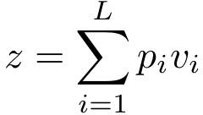
Image Captioning with Attention
Distribution over L locations
a1
CNN
h0
Features: L x D
Image: H x W x 3
Weighted
z1
features: D
Weighted combination of features
Xu et al, “Show, Attend and Tell: Neural
Image Caption Generation with Visual Attention”, ICML 2015
Fei-Fei Li & Justin Johnson & Serena Yeung
Fei-Fei Li & Justin Johnson & Serena Yeung Lecture 10 - May 2, 2019

Slide 72
Image Captioning with Attention
Distribution over L locations
a1
CNN
h0
h1
Features: L x D
Image: H x W x 3
Weighted
z1
y1
features: D
Weighted combination of features
Xu et al, “Show, Attend and Tell: Neural
Image Caption Generation with Visual Attention”, ICML 2015
First word
Fei-Fei Li & Justin Johnson & Serena Yeung
Fei-Fei Li & Justin Johnson & Serena Yeung Lecture 10 - May 2, 2019

Slide 73
Image Captioning with Attention
Distribution over L locations
Distribution over vocab
a1
a2
d1
CNN
h0
h1
Features: L x D
Image: H x W x 3
Weighted
z1
y1
features: D
Weighted combination of features
Xu et al, “Show, Attend and Tell: Neural
Image Caption Generation with Visual Attention”, ICML 2015
First word
Fei-Fei Li & Justin Johnson & Serena Yeung
Fei-Fei Li & Justin Johnson & Serena Yeung Lecture 10 - May 2, 2019

Slide 74
Image Captioning with Attention
Distribution over L locations
Distribution over vocab
a1
a2
d1
CNN
h0
h1
h2
Features: L x D
Image: H x W x 3
Weighted
z1
y1
z2
y2
features: D
Weighted combination of features
Xu et al, “Show, Attend and Tell: Neural
Image Caption Generation with Visual Attention”, ICML 2015
First word
Fei-Fei Li & Justin Johnson & Serena Yeung
Fei-Fei Li & Justin Johnson & Serena Yeung Lecture 10 - May 2, 2019

Slide 75
Image Captioning with Attention
Distribution over L locations
Distribution over vocab
a1
a2
d1
a3
d2
CNN
h0
h1
h2
Features: L x D
Image: H x W x 3
Weighted
z1
y1
z2
y2
features: D
Weighted combination of features
Xu et al, “Show, Attend and Tell: Neural
Image Caption Generation with Visual Attention”, ICML 2015
First word
Fei-Fei Li & Justin Johnson & Serena Yeung
Fei-Fei Li & Justin Johnson & Serena Yeung Lecture 10 - May 2, 2019

Slide 76
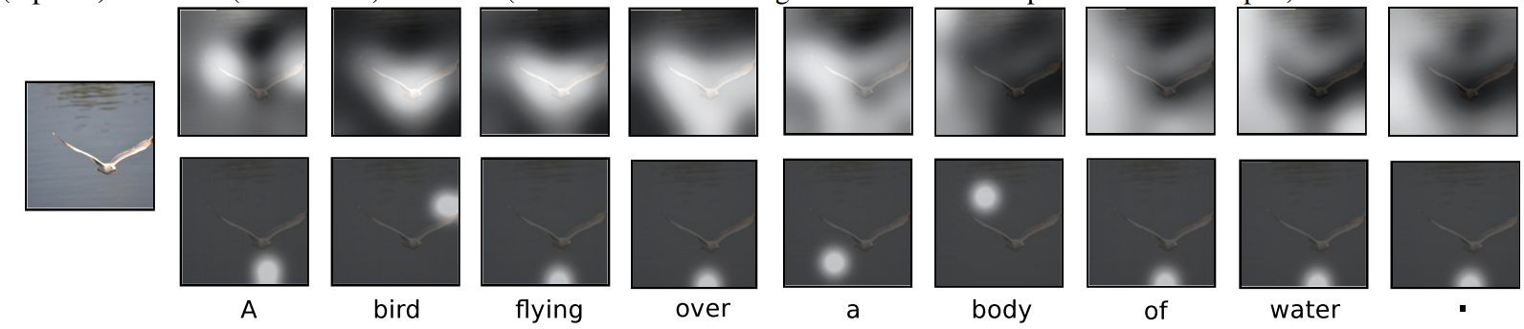
Image Captioning with Attention
Soft attention
Hard attention
Xu et al, “Show, Attend, and Tell: Neural Image Caption Generation with Visual Attention”, ICML 2015
Figure copyright Kelvin Xu, Jimmy Lei Ba, Jamie Kiros, Kyunghyun Cho, Aaron Courville, Ruslan Salakhutdinov, Richard S. Zemel, and Yoshua Benchio, 2015. Reproduced with permission.
Fei-Fei Li & Justin Johnson & Serena Yeung
Fei-Fei Li & Justin Johnson & Serena Yeung Lecture 10 - May 2, 2019

Slide 77
Soft Attention and Hard Attention
Soft Attention : 모든 feature vector에 attention
Hard Attention : Attention을 feature vector sampling에 활용 -> Non differentiable 하므로 Reinforcement Learning 등을 활용

Slide 78

Image Captioning with Attention
Xu et al, “Show, Attend, and Tell: Neural Image Caption Generation with Visual Attention”, ICML 2015
Figure copyright Kelvin Xu, Jimmy Lei Ba, Jamie Kiros, Kyunghyun Cho, Aaron Courville, Ruslan Salakhutdinov, Richard S. Zemel, and Yoshua Benchio, 2015. Reproduced with permission.
Fei-Fei Li & Justin Johnson & Serena Yeung
Fei-Fei Li & Justin Johnson & Serena Yeung Lecture 10 - May 2, 2019

Slide 79

Visual Question Answering
Agrawal et al, “VQA: Visual Question Answering”, ICCV 2015
Zhu et al, “Visual 7W: Grounded Question Answering in Images”, CVPR 2016
Figure from Zhu et al, copyright IEEE 2016. Reproduced for educational purposes.
Fei-Fei Li & Justin Johnson & Serena Yeung
Fei-Fei Li & Justin Johnson & Serena Yeung Lecture 10 - May 2, 2019

Slide 80



Visual Question Answering: RNNs with Attention
Zhu et al, “Visual 7W: Grounded Question Answering in Images”, CVPR 2016
Figures from Zhu et al, copyright IEEE 2016. Reproduced for educational purposes.
Fei-Fei Li & Justin Johnson & Serena Yeung
88
Fei-Fei Li & Justin Johnson & Serena Yeung Lecture 10 - May 2, 2019

Slide 81



Multilayer RNNs
Generally 3~4 hidden layers
LSTM:
depth
time
Fei-Fei Li & Justin Johnson & Serena Yeung
Fei-Fei Li & Justin Johnson & Serena Yeung Lecture 10 - May 2, 2019

Slide 82

Vanilla RNN Gradient Flow
Bengio et al, “Learning long-term dependencies with gradient descent is difficult”, IEEE Transactions on Neural Networks, 1994
Pascanu et al, “On the difficulty of training recurrent neural networks”, ICML 2013
W
tanh
stack
h_{t}
^{h}t-1
x_{t}
Fei-Fei Li & Justin Johnson & Serena Yeung
Fei-Fei Li & Justin Johnson & Serena Yeung Lecture 10 - May 2, 2019

Slide 83
Vanilla RNN Gradient Flow
Bengio et al, “Learning long-term dependencies with gradient descent is difficult”, IEEE Transactions on Neural Networks, 1994
Pascanu et al, “On the difficulty of training recurrent neural networks”, ICML 2013
Backpropagation from h_{t} to h_{t-1} multiplies by W
(actually W
T₎
hh
W
tanh
stack
h_{t}
^{h}t-1
x_{t}
Fei-Fei Li & Justin Johnson & Serena Yeung
Fei-Fei Li & Justin Johnson & Serena Yeung Lecture 10 - May 2, 2019

Slide 84

Vanilla RNN Gradient Flow
Bengio et al, “Learning long-term dependencies with gradient descent is difficult”, IEEE Transactions on Neural Networks, 1994
Pascanu et al, “On the difficulty of training recurrent neural networks”, ICML 2013
h₀
h₁
h₂
h₃
h₄
x₁
x₂
x₃
x₄
Largest singular value > 1:
Exploding gradients
Computing gradient of h₀ involves many factors of W
(and repeated tanh)
Largest singular value < 1:
Vanishing gradients
Fei-Fei Li & Justin Johnson & Serena Yeung
Fei-Fei Li & Justin Johnson & Serena Yeung Lecture 10 - May 2, 2019

Slide 85

Vanilla RNN Gradient Flow
Bengio et al, “Learning long-term dependencies with gradient descent is difficult”, IEEE Transactions on Neural Networks, 1994
Pascanu et al, “On the difficulty of training recurrent neural networks”, ICML 2013
h₀
h₁
h₂
h₃
h₄
x₁
x₂ x₃
x₄
Largest singular value > 1:
Exploding gradients
Gradient clipping: Scale gradient if its norm is too big
Computing gradient of h₀ involves many factors of W
(and repeated tanh)
Largest singular value < 1:
Vanishing gradients
Fei-Fei Li & Justin Johnson & Serena Yeung
Fei-Fei Li & Justin Johnson & Serena Yeung Lecture 10 - May 2, 2019

Slide 86
Vanilla RNN Gradient Flow
Bengio et al, “Learning long-term dependencies with gradient descent is difficult”, IEEE Transactions on Neural Networks, 1994
Pascanu et al, “On the difficulty of training recurrent neural networks”, ICML 2013
h₀
h₁
h₂
h₃
h₄
x₁
x₂
x₃
x₄
Largest singular value > 1:
Exploding gradients
Computing gradient of h₀ involves many factors of W
(and repeated tanh)
Largest singular value < 1:
Vanishing gradients
Change RNN architecture
Fei-Fei Li & Justin Johnson & Serena Yeung
Fei-Fei Li & Justin Johnson & Serena Yeung Lecture 10 - May 2, 2019

Slide 87


Long Short Term Memory (LSTM)
Vanilla RNN LSTM
Hochreiter and Schmidhuber, “Long Short Term Memory”, Neural Computation 1997
Fei-Fei Li & Justin Johnson & Serena Yeung
Fei-Fei Li & Justin Johnson & Serena Yeung Lecture 10 - May 2, 2019

Slide 88
Long Short Term Memory (LSTM)
[Hochreiter et al., 1997]
i: Input gate, whether to write to cell
f: Forget gate, Whether to erase cell
o: Output gate, How much to reveal cell
g: Gate gate (?), How much to write to cell
vector from below (x)
W
x
sigmoid
i
h
sigmoid
f
vector from before (h)
sigmoid
o
tanh
g
4h x 2h
4h
4*h
Fei-Fei Li & Justin Johnson & Serena Yeung
Fei-Fei Li & Justin Johnson & Serena Yeung Lecture 10 - May 2, 2019

Slide 89

LSTM 정리
i : 현재 cell state을 얼마나 기억할 것인지
f : 이전 cell state을 얼마나 잊을 것인지
o : hidden state으로 어떤 부분을 highligt할 것인지

Slide 90
Long Short Term Memory (LSTM)
[Hochreiter et al., 1997]
☉
+
c_{t}
^{c}t-1
f i g
W
☉
tanh
^{h}t-1
stack
o
☉
h_{t}
x_{t}
Fei-Fei Li & Justin Johnson & Serena Yeung
Fei-Fei Li & Justin Johnson & Serena Yeung Lecture 10 - May 2, 2019

Slide 91
Long Short Term Memory (LSTM): Gradient Flow
[Hochreiter et al., 1997]
Backpropagation from c_{t} to
c_{t-1} only elementwise multiplication by f, no matrix multiply by W
c
☉ + c
t-1
t
f i g
W
☉
tanh
^{h}t-1
stack
o
☉
h_{t}
x_{t}
Fei-Fei Li & Justin Johnson & Serena Yeung
Fei-Fei Li & Justin Johnson & Serena Yeung Lecture 10 - May 2, 2019

Slide 92


Long Short Term Memory (LSTM): Gradient Flow
[Hochreiter et al., 1997]
Uninterrupted gradient flow!
c₀ c₁ c₂
c₃
In between:
Highway Networks
Similar to ResNet!
3x3 conv, 128
3x3 conv, 128
3x3 conv, 128
3x3 conv, 128
3x3 conv, 128
3x3 conv, 128 / 2
3x3 conv, 64
3x3 conv, 64
3x3 conv, 64
3x3 conv, 64
3x3 conv, 64
3x3 conv, 64
Pool
7x7 conv, 64 / 2 Input
Softmax FC 1000
Pool
3x3 conv, 64
3x3 conv, 64
3x3 conv, 64
3x3 conv, 64
3x3 conv, 64
3x3 conv, 64
...
Srivastava et al, “Highway Networks”, ICML DL Workshop 2015
Fei-Fei Li & Justin Johnson & Serena Yeung
92
Fei-Fei Li & Justin Johnson & Serena Yeung Lecture 10 - May 2, 2019

Slide 93


Other RNN Variants
[An Empirical Exploration of Recurrent Network Architectures, Jozefowicz et al., 2015]
GRU [Learning phrase representations using rnn encoder-decoder for statistical machine translation, Cho et al. 2014]
[LSTM: A Search Space Odyssey, Greff et al., 2015]
Fei-Fei Li & Justin Johnson & Serena Yeung
93
Fei-Fei Li & Justin Johnson & Serena Yeung Lecture 10 - May 2, 2019

Slide 94

LSTM / GRU
forget gate가 z(update gate)와 r(reset gate)으로 나누어짐)
cell state 안쓰고 hidden state만 사용
Computationally Efficient
Empirical Evaluation of Gated Recurrent Neural Networks on Sequence Modeling , Chung et el, 2014

Slide 95

Recently in Natural Language Processing… New paradigms for reasoning over sequences
[“Attention is all you need”, Vaswani et al., 2018]
New “Transformer” architecture no longer processes inputs sequentially; instead it can operate over inputs in a sequence in parallel through an attention mechanism
Has led to many state-of-the-art results and pre-training in NLP, for more interest see e.g.
“BERT: Pre-training of Deep Bidirectional Transformers for Language Understanding”, Devlin et al., 2018
OpenAI GPT-2, Radford et al., 2018
Fei-Fei Li & Justin Johnson & Serena Yeung
95
Fei-Fei Li & Justin Johnson & Serena Yeung Lecture 10 - May 2, 2019

